Slide 1

ALGO VISUALIZER
BHARATI VIDYAPEETH’S
INSTITUTE OF COMPUTER APPLICATIONS & MANAGEMENT
(Affiliated to Guru Gobind Singh Indraprastha University, Approved by AICTE, New Delhi)

Slide 2
ALGO VISUALIZER
MADE BY –
ANUP VERMA(35335304420)
SHRUTI NIGAM(04435304420)

Slide 3
CONTENTS
PROBLEM STATEMENT
OBJECTIVE
DIAGRAMS
TECHNOLOGY USED
TESTING AND TEST RESULTS
BIBLIOGRAPHY

Slide 4
PROBLEM STATEMENT
While dealing with arrays , the programmer always wonder which algorithm will take less space and time. Programmers look for an algorithm which is optimize.
It helps the programmer for better visualization and practical implementation.

Slide 5
OBJECTIVE
To understand the functioning of various data structure sorting algorithm using simple bar graphs with variable speed.

Slide 6
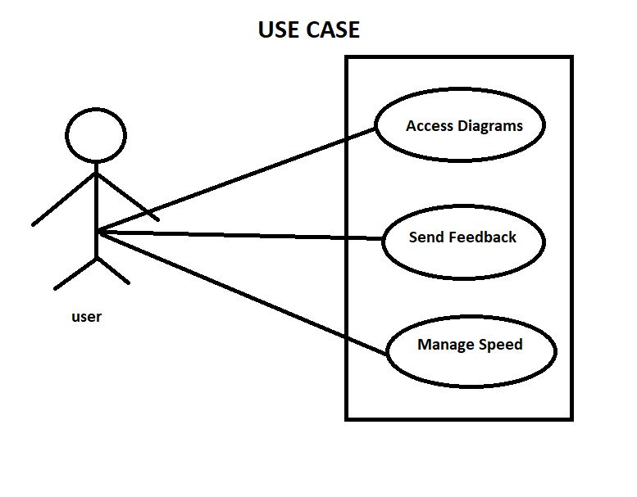

Slide 7
TECHNOLOGY USED
FRONTEND LANGUAGES
HTML
CSS
BOOTSTRAP
TAILWIND
BACKEND LANGUAGE
JAVASCRIPT
TEXT EDITOR
VISUAL STUDIO CODE(VSCODE)

Slide 8
TEST RESULTS

Slide 9
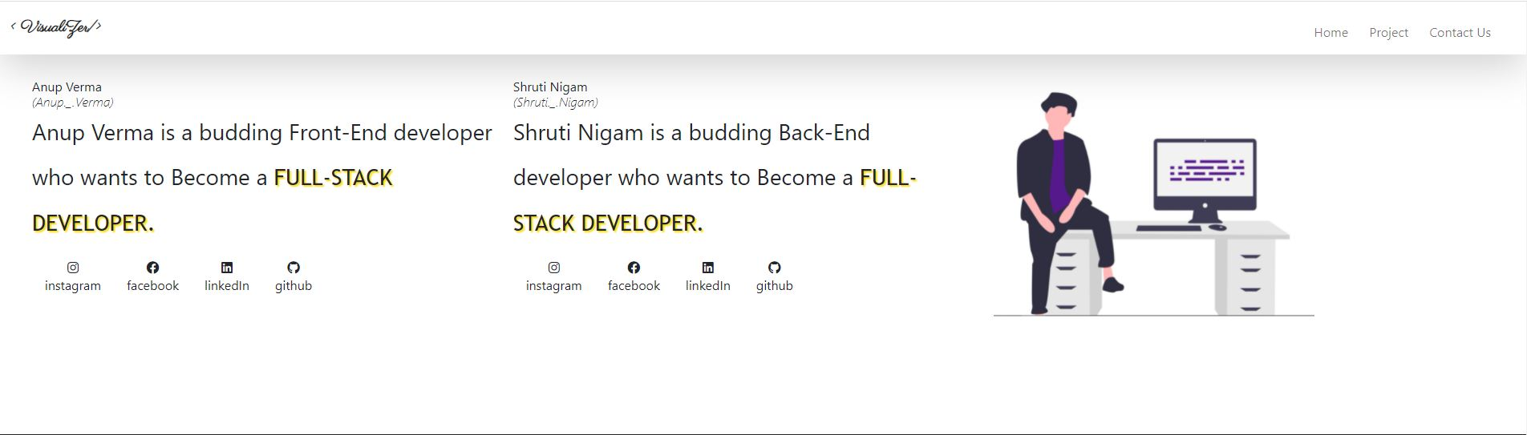
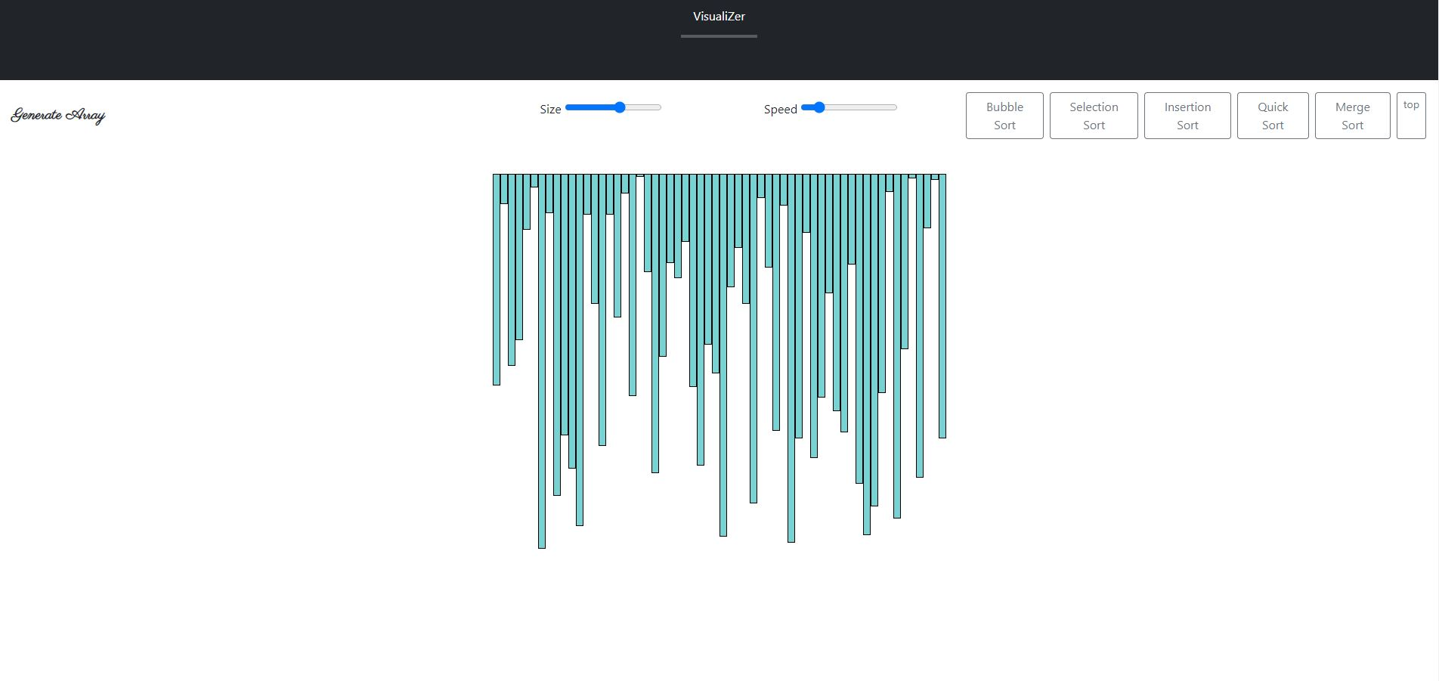
WEB VIEW

Slide 10
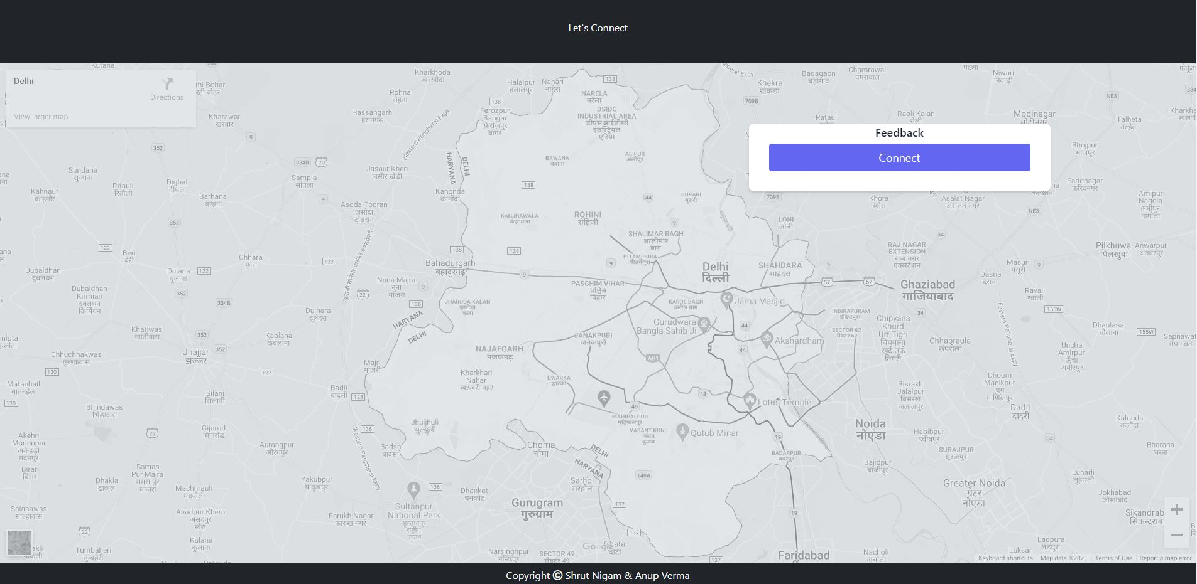
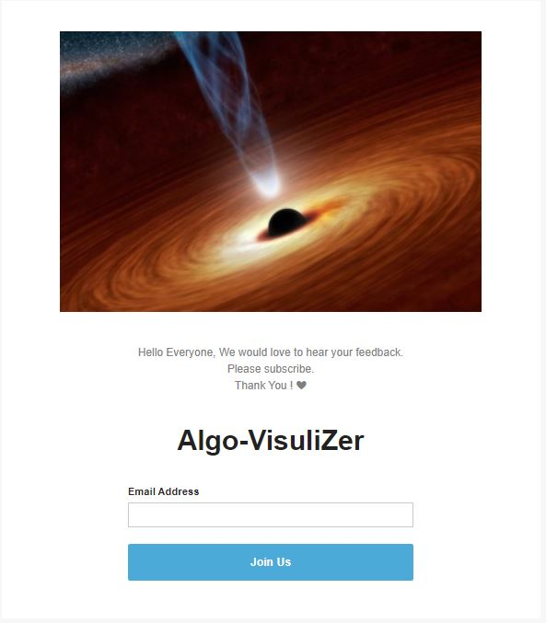
WEB VIEW

Slide 11
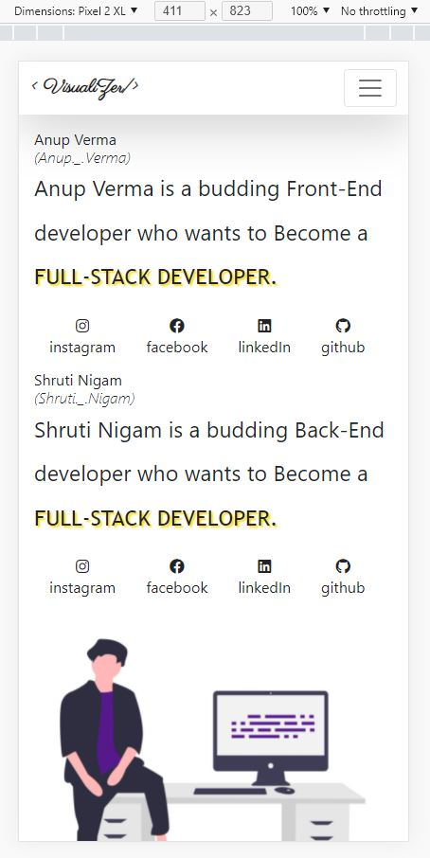
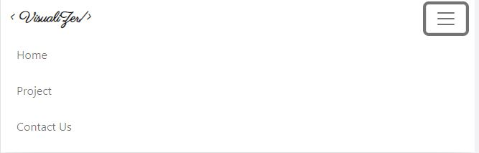
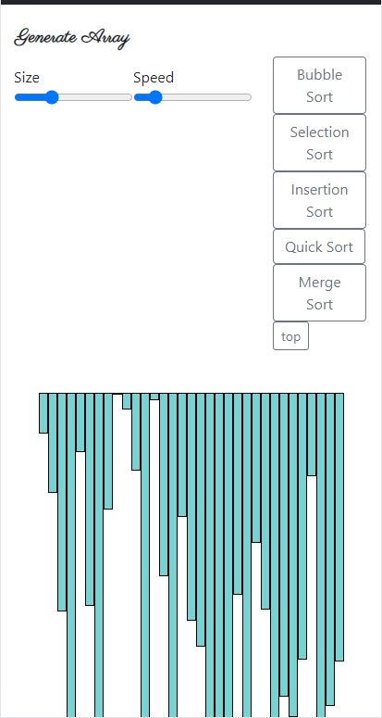
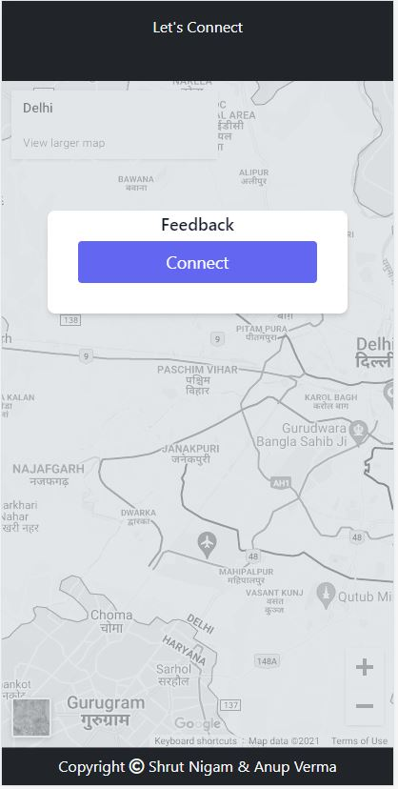
MOBILE VIEW

Slide 12
Future Scope
Incorporate Path Finding Algorithms
Statistical Representation of Algorithms
Incorporate Login/Signup Functionalities and provide personal Code Space

Slide 13
BIBLIOGRAPHY
https://github.com/Anup-Verma98/Algo-Visualizer.git
https://tailwindcss.com/docs
https://fonts.google.com/
https://github.com
https://getbootstrap.com/docs/5.1/getting-started/introduction/
Research Papers :
https://www.researchgate.net/publication/273496790_Using_algorithm_visualizations_in_computer_science_education

Slide 14
THANK YOU!
SHRUTI NIGAM(04435304420)
ANUP VERMA(35335304420)

